Slide 1
Tableau Module 2
Data Analytics

Slide 2


























Common Charts
Data Views
Hierarchies
Data Structures
Basic Navigation
Dashboards
Data Stories
Calculations
Advanced
Charts
You are here
Certification Springs
Blending
Done

Slide 3
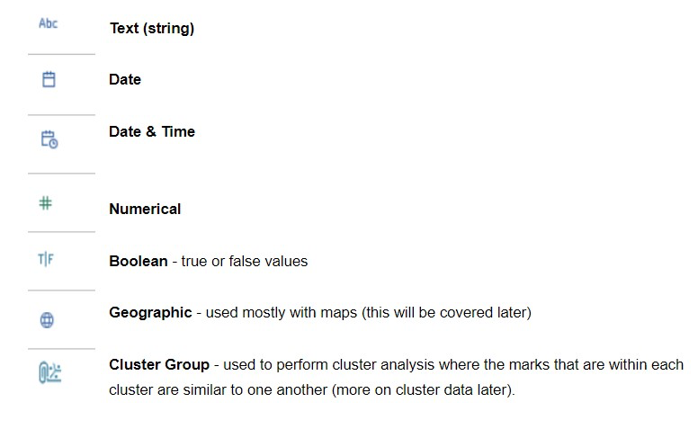
Data Types

Slide 4
Measures vs Dimensions
Measures
Dimension
Continuous (usually)
Quantifications
Numeric (cardinal)
DateTime
Discrete (usually)
Categorical
Numeric (index or ordinal)
Date (month, year, day, etc)

Slide 5
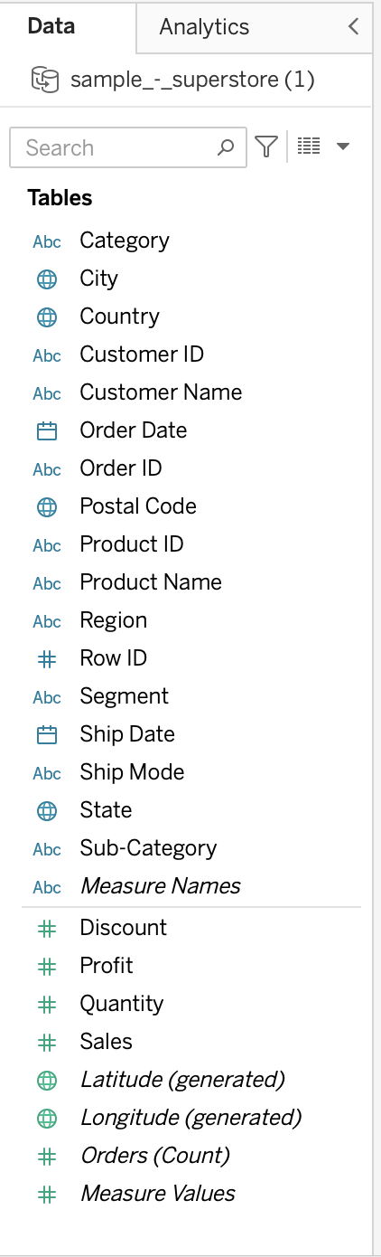
Dimensions and Measures
Dimensions
Measures

Slide 6
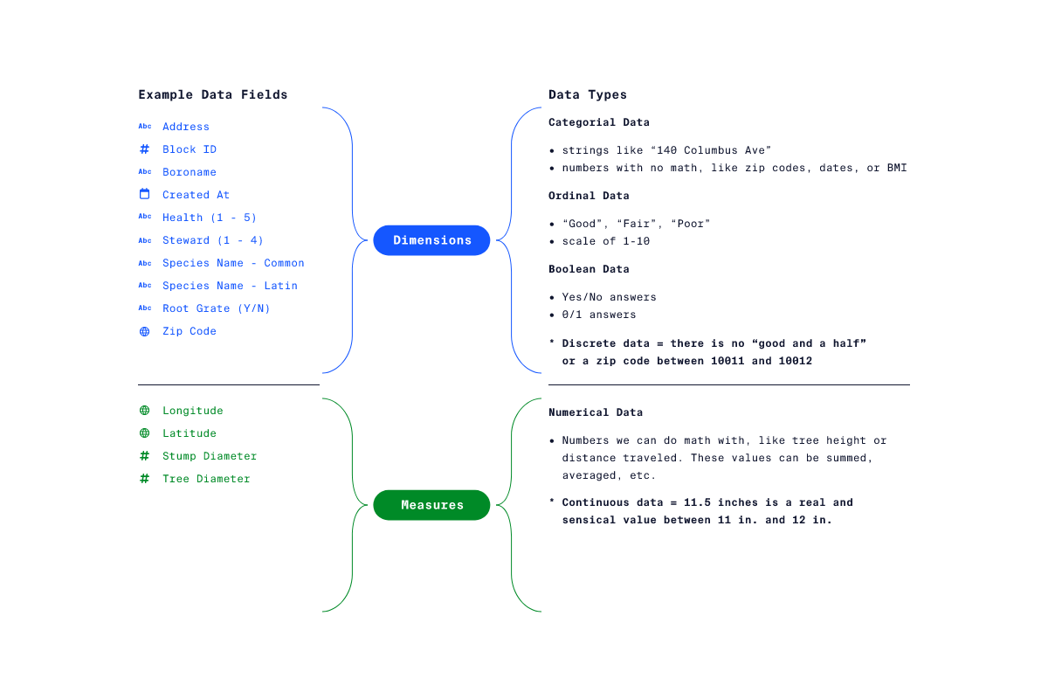
Dimensions and Measures

Slide 7
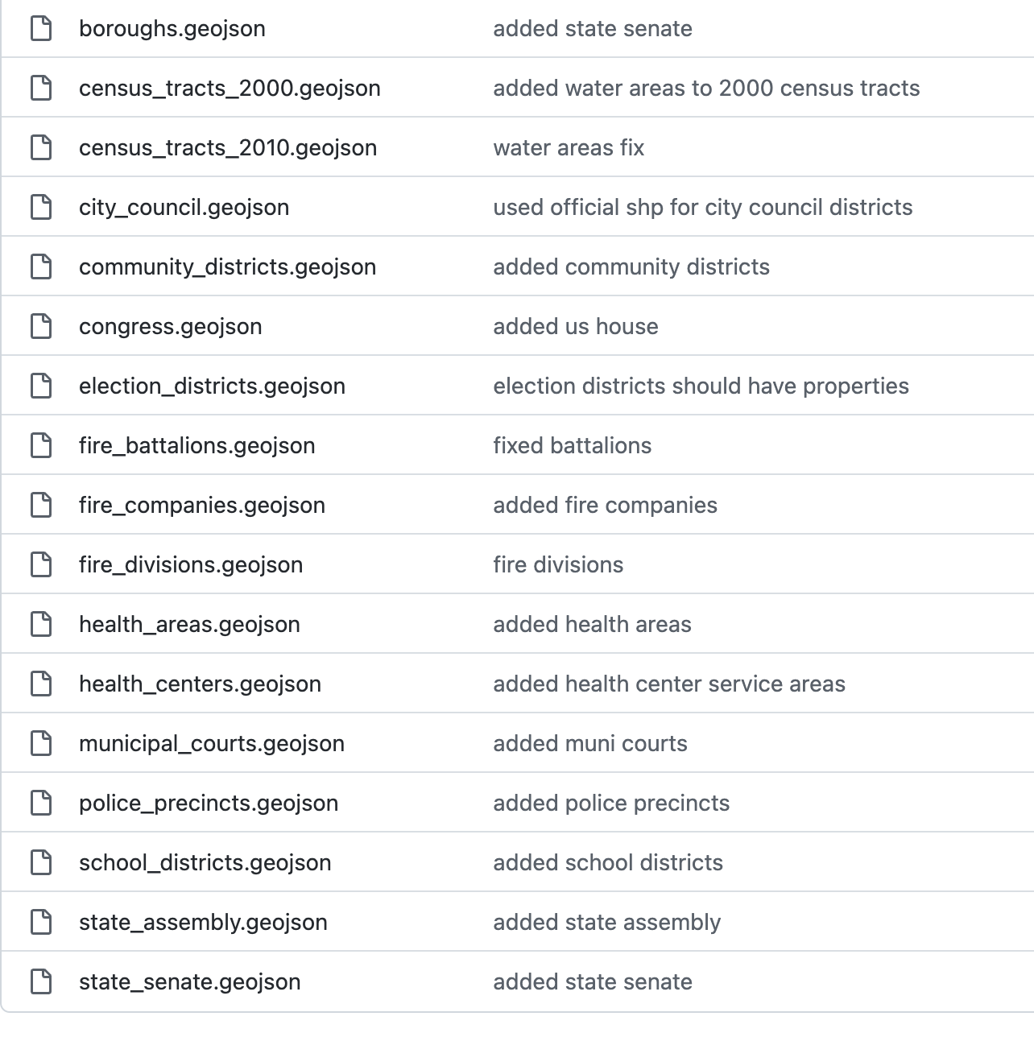
Geo Data
https://github.com/dwillis/nyc-maps

Slide 8
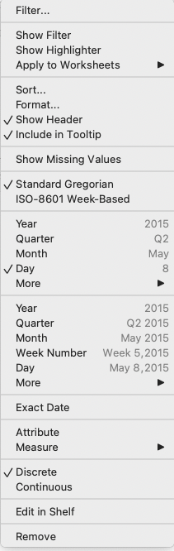
Dates and Times
Discrete Dates (Dimensions)
Continuous Dates (Measures)

Slide 9
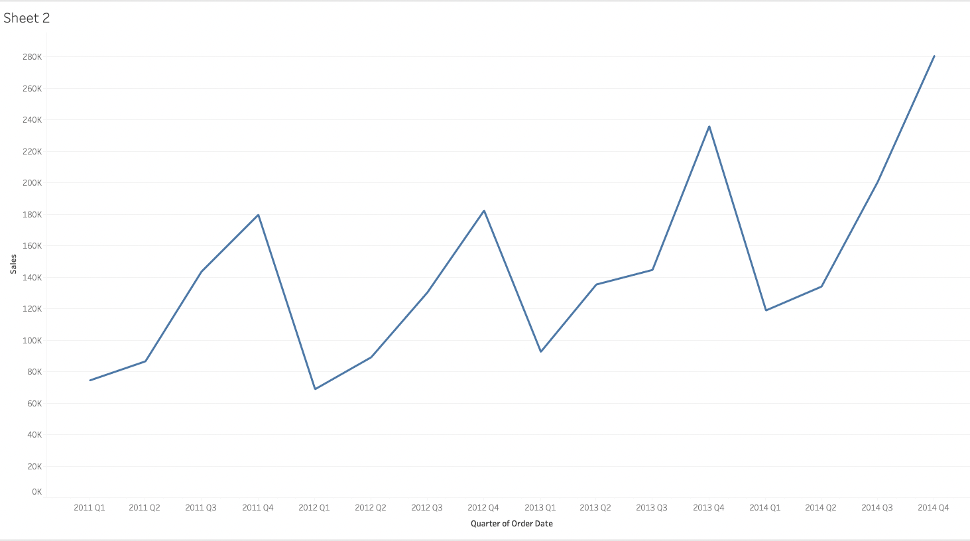
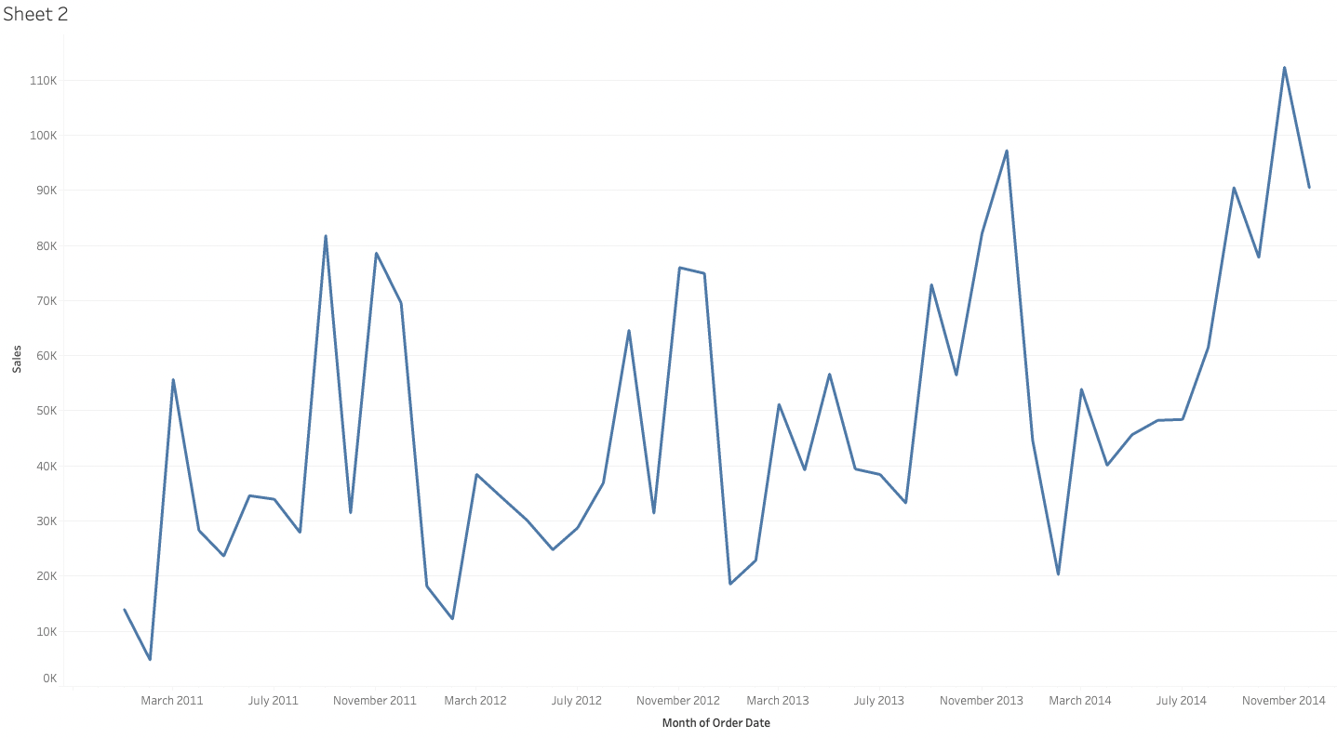
Continuous
Dates
Quarterly
Monthly

Slide 10
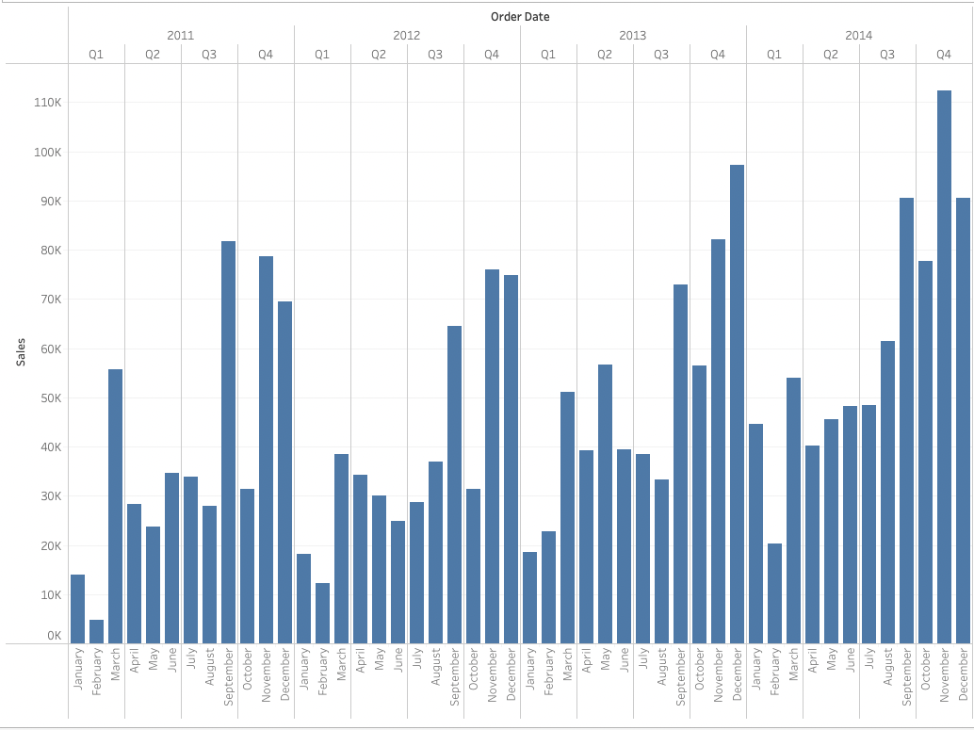
Discrete Dates

Slide 11
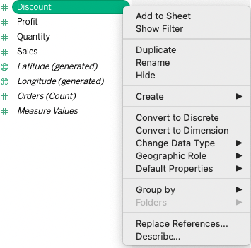
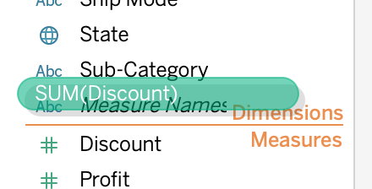
Converting Data Types

Slide 12
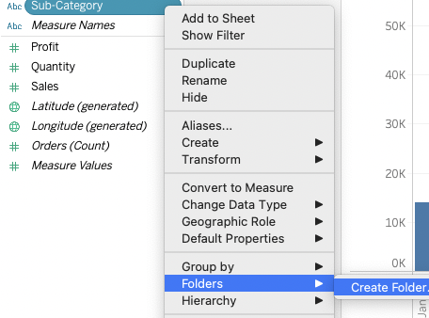
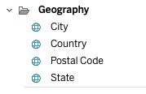
Folders
Used to ‘reduce clutter’
Doesn’t change data

Slide 13
Challenge part 1
Using the superstore.xlsx dataset
Create a bar chart with Sub-category in columns and Sales in rows
Change sales(sum) to sales(avg)
Sort the bars in descending order
Drag Category to the color tile on the marks card and drop it
Create a new (blank) worksheet
Drag State into the canvas and drop it anywhere
Drag Sales over the color tile in the marks card
Click on the color tile, and select “Edit Colors”. Change the color scale so that dark green means more $$$

